Slide 1
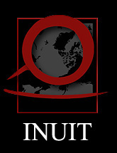
Indigenous Knowledge & Arctic Assessments
Prepared by: Carolina Behe
Association of Polar Early Career Scientists
April 24, 2017
Notes:
Introduction

Slide 2
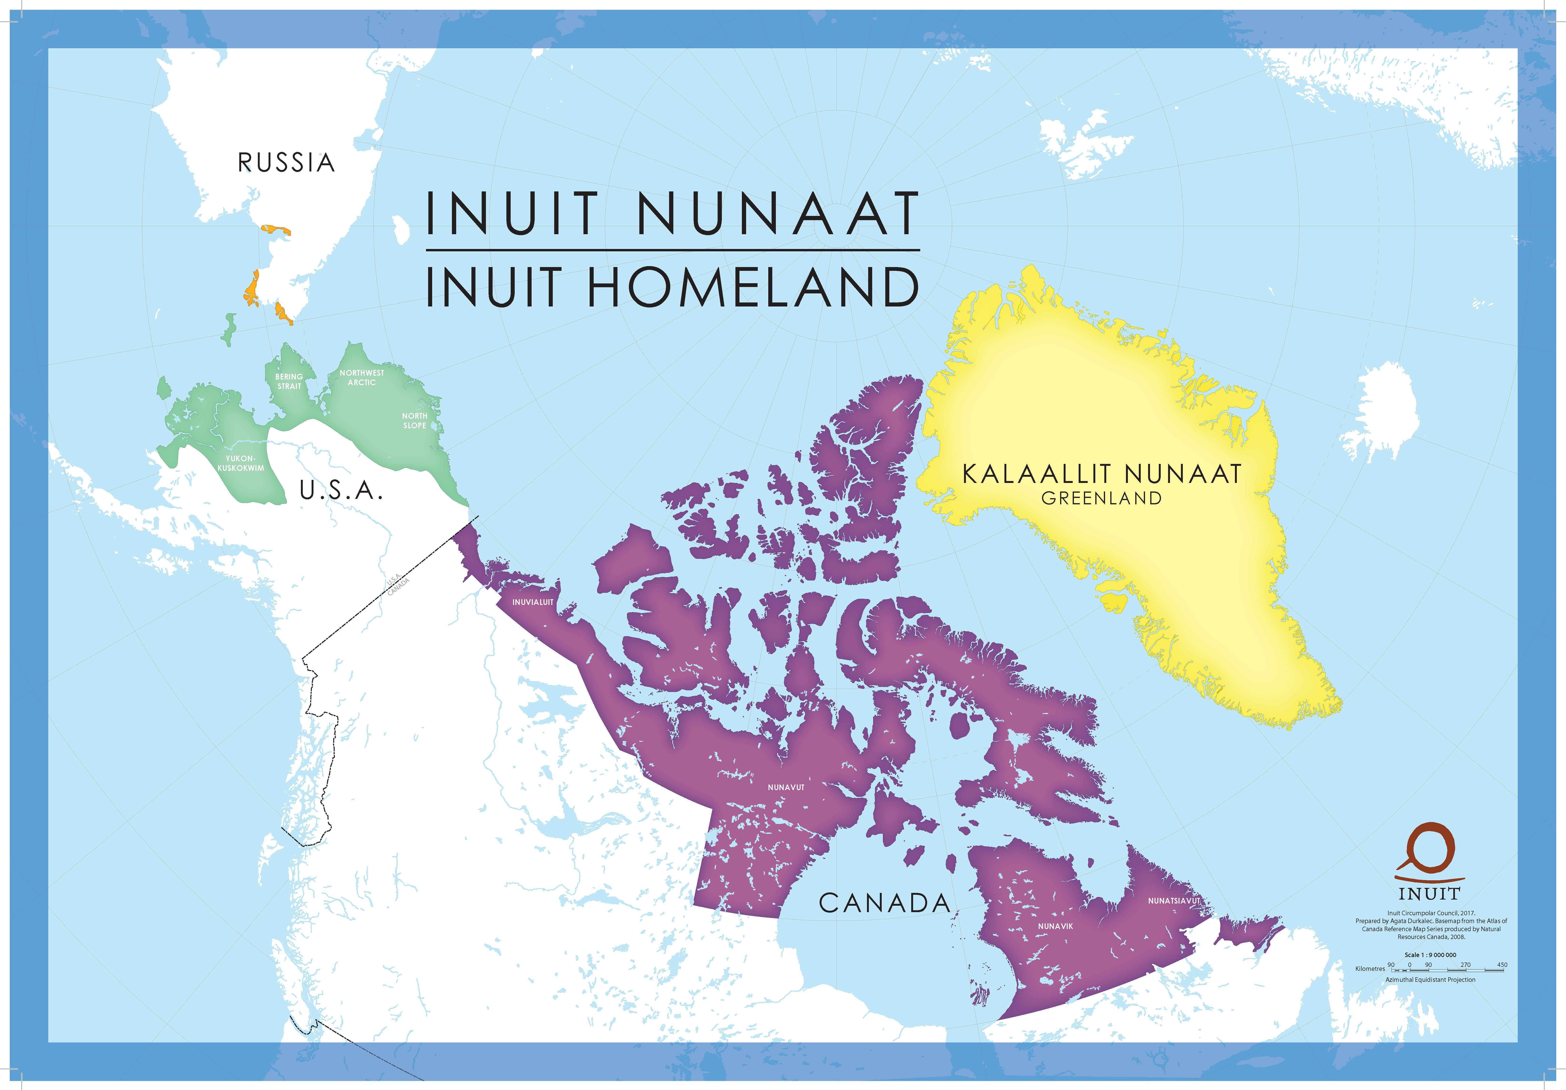
Notes:
Who is ICC
Indigenous Knowledge and Assessments – we will frame this discussion within the Arctic Council…though we address these topics through a few other forums.

Slide 3
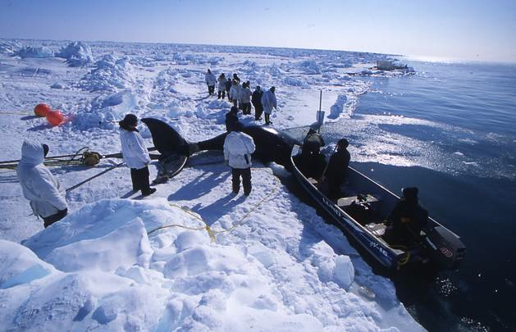
Ottawa Declaration
“Recognizing the traditional knowledge of the indigenous people of the Arctic and their communities and taking note of its importance and that of Arctic science and research to the collective understanding of the circumpolar Arctic” (pg 2).
North Slope Borough
Notes:
Arctic Council and Indigenous Knowledge…The Arctic Council has noted the importance of Arctic Indigenous peoples and their knowledge since their formation. Here is language from the Ottawa declaration. You will find similar language throughout pass and the current declaration.
In 2014, under the Canadian chairmanship and funded by Canada, the PPs developed a definition for Indigenous Peoples’ Traditional Knowledge and guiding principles for the engagement of this knowledge.
This definition emphasizes that IK is a systematic way of thinking. That it holds its own methodologies and evaluation processes.
There is reasoning behind its findings. Please keep that in mind as we discuss why it is crucial for assessment processes to be built off of both IK and science. It is important to remember that these are unique knowledge systems. That should not be translated into each other – but instead, we need to aim for a co-production of knowledge.

Slide 4
Ottawa Indigenous Knowledge Principles
a systematic way of thinking and knowing
developing in a living process, including knowledge acquired today and in the future
holds methodologies, evaluation and validation process
Notes:
Now you will see that this document refers to our knowledge as Traditional Knowledge. For ICC, we use the term Indigenous Knowledge. It more adequately reflects what we are discussing. We, ICC, have our own definition – which is very similar to this one. When we say Indigenous Knowledge or IK – this definition is what we are referring to.
Words – working internationally and with so many different cultures, it can become easy to dismiss different uses in words as simply symantics.…but it is much more than that – this is about self determination…
for Indigenous Peoples to have the right to define and refer to their own knowledge system in a way that they have determined appropriate.
Supporting self determination of Indigenous Peoples is a key aspect to building collaborative partnerships – a partnership that we need to more fully understand what is occurring within the Arctic.
This is what we conduct assessments for – to understand our world, the changes that are occurring, to understand impacts and opportunities to new decisions and to inform decisions to manage human behavior.
What we decide to include within an assessment or decide what questions will drive the assessment are determined by how we are taught to see the world – how we are taught to take information in.

Slide 5
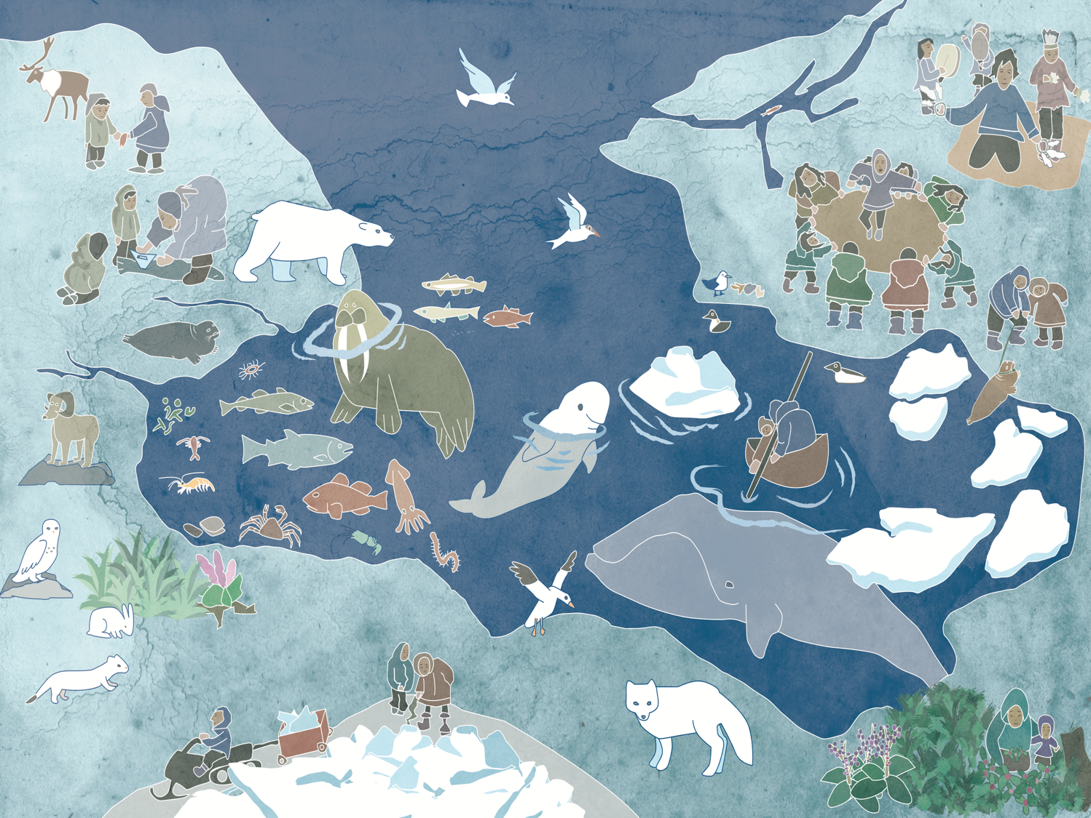
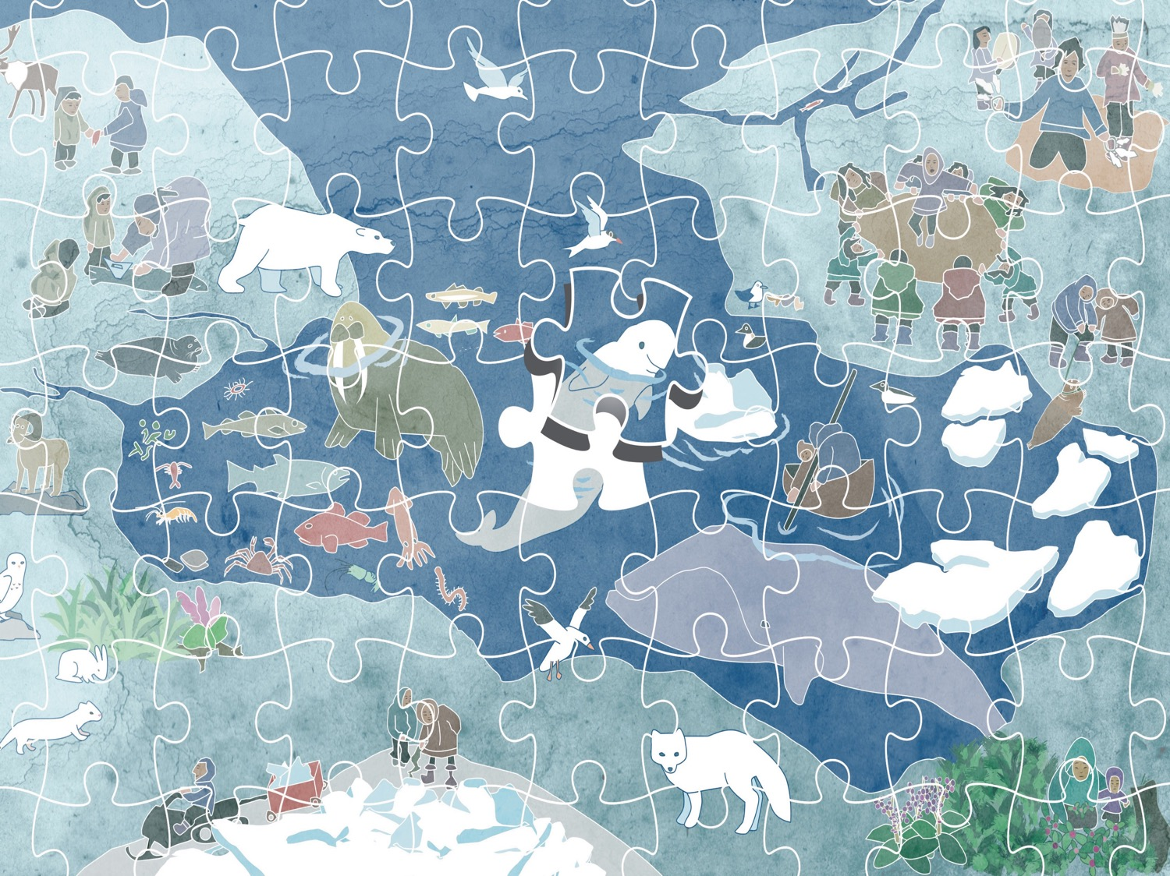
Notes:
This is the Inuit ecosystem. We drew this ecosystem for our food security work done in Alaska. But it may aid us in explaining how the world is being looked at from an Inuit perspective – from an Indigenous perspective.
This ecosystem is made up of many, many parts – please notice that there is not meant to be a hierarchy here. Everything is needed and is as important. Here you have feast – this is as important as these polikeets down here – and this zooplankton is as important as this lichen, and here a youth share his first catch.
Push for puzzle to come up
As one elder explained – The Arctic ecosystem is like puzzle pieces. You have language here, sharing, education. And all of this makes up the entire picture. These pieces are continuous adjusting to each other – but are all connected. Scientists often think of these puzzle pieces as systems. These systems are interlinking – language is part of a system and is interlink with biodiversity and with hydro-systems, and so on.
In Alaska, when doing our food security work – IK tells us that the greatest points of vulnerability lie where these systems interconnect. If the systems begin to separate – to not connect – there is a large problem – maybe a tipping point.
When we think about assessments, it is important that we consider what IK is telling us here. Here IK is paying attention to relationships as oppose to individual pieces.

Slide 6
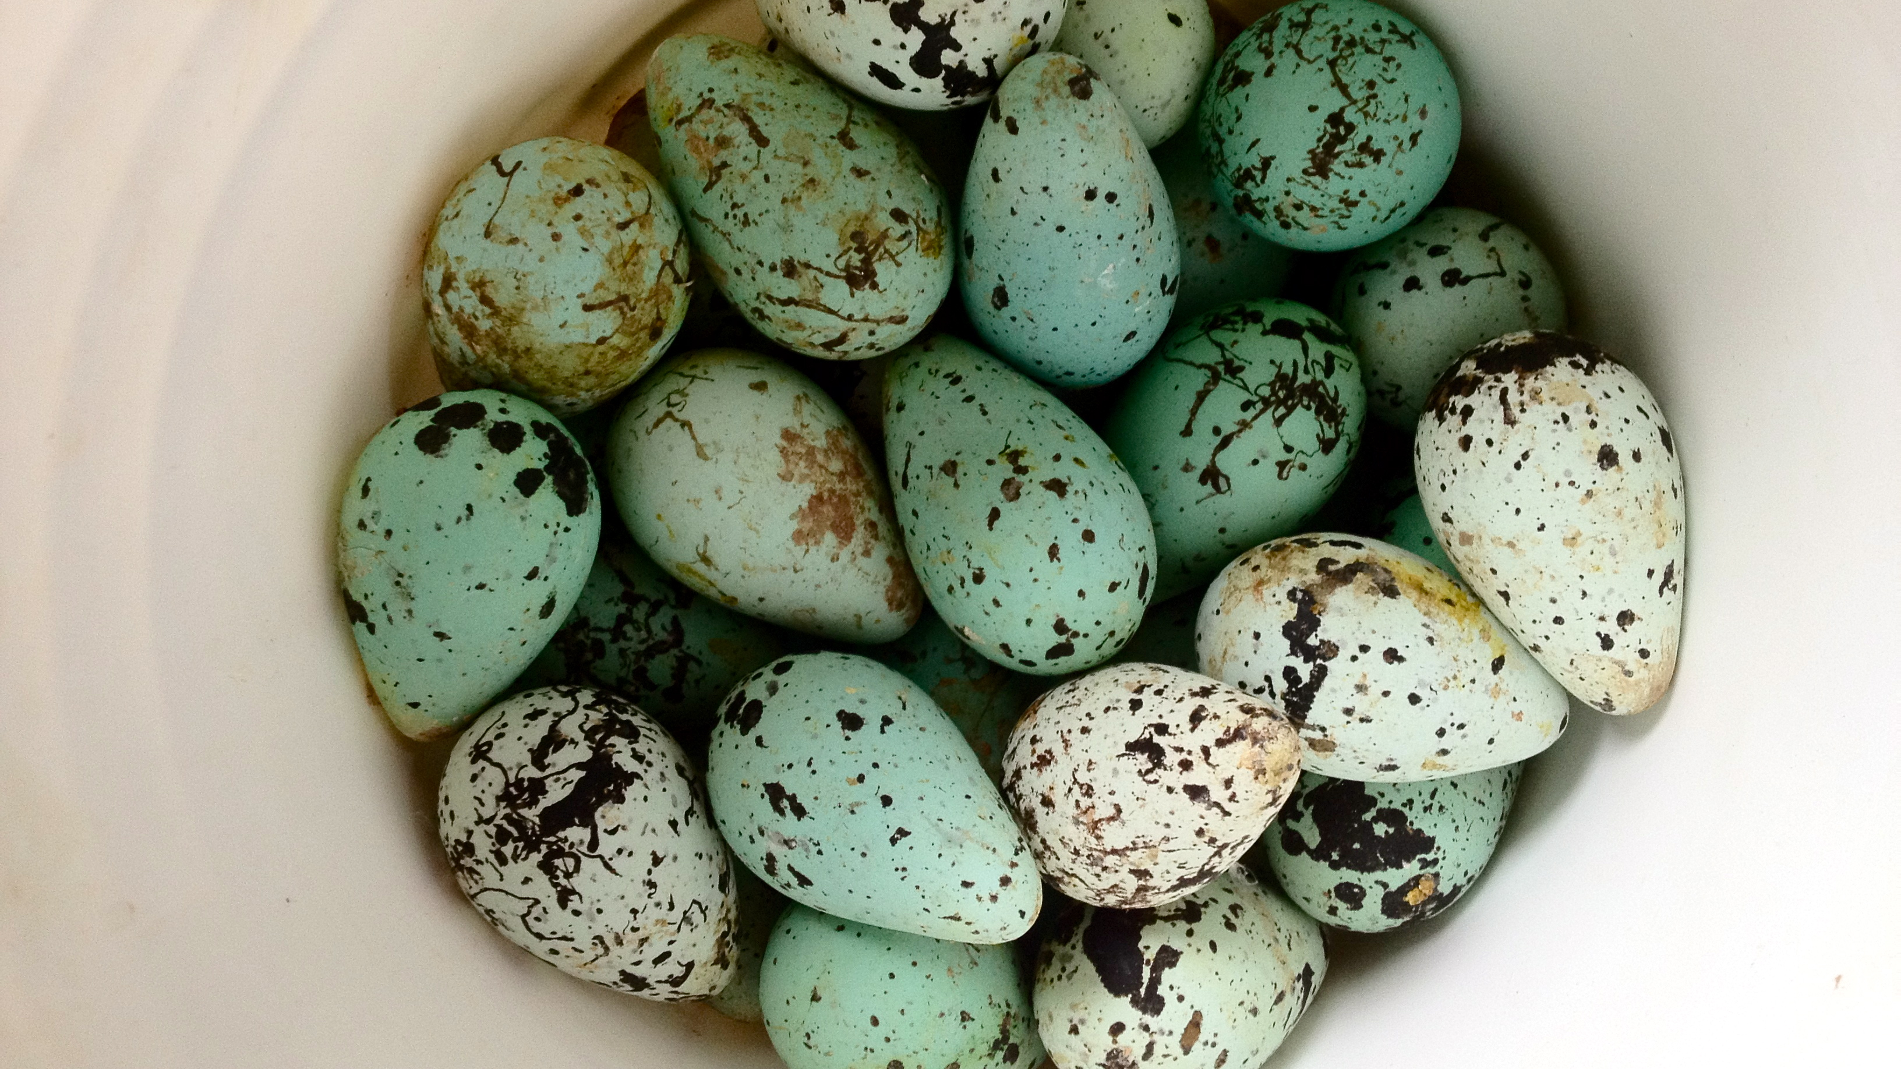
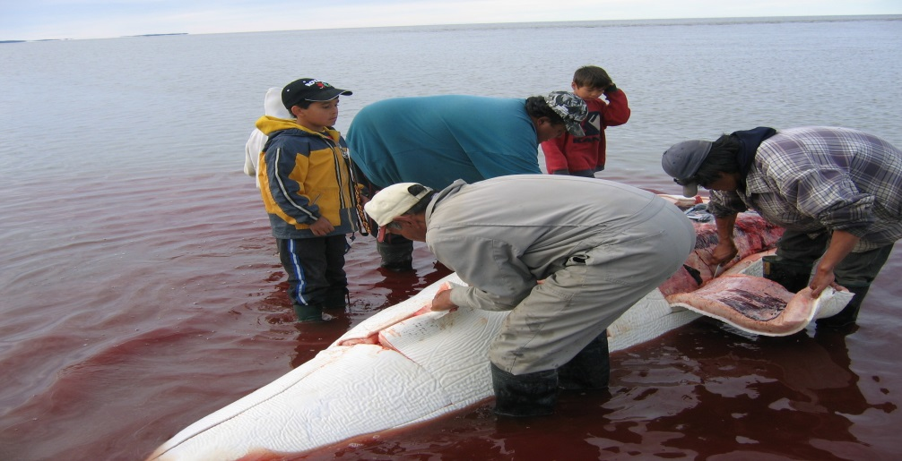
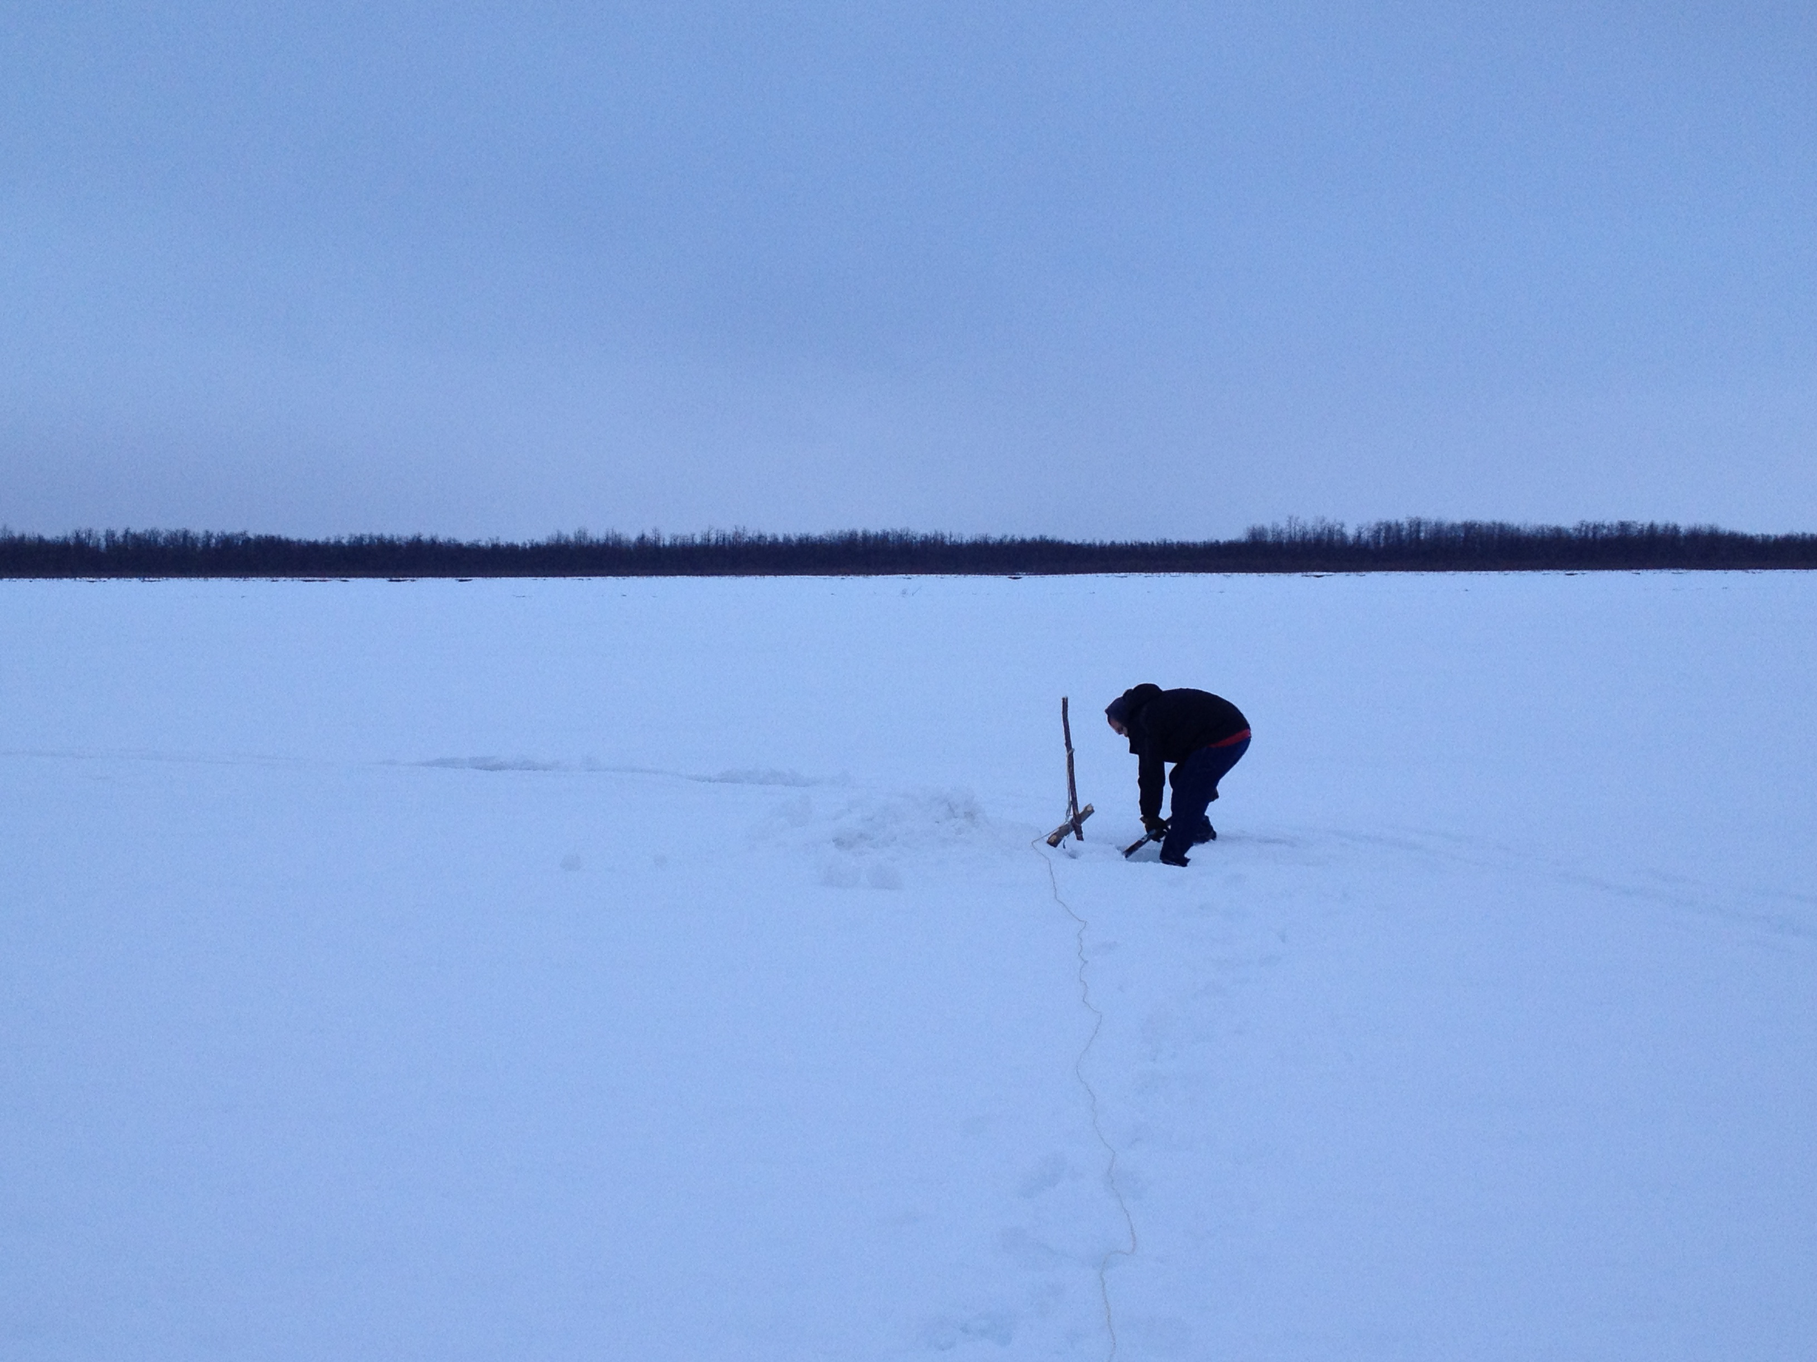
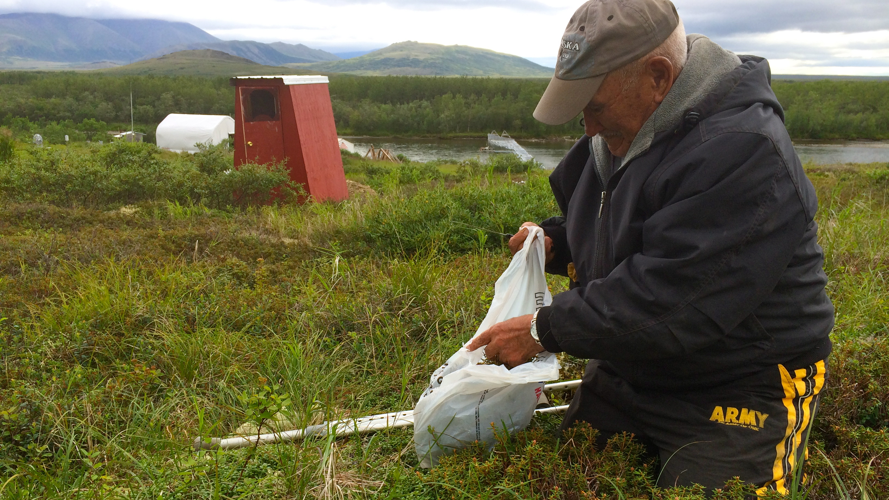
Photo: Jacki Clevland
Photo: Jacki Clevland
Photo: Carolina Behe
Photo: Jacki Clevland
Notes:
To conduct assessments, we need both IK and science –we need to recognize that science and IK are different and that is good. We are often asking different questions – and both questions are needed to see the entire puzzle.
When asked – at what point should IK be engaged in assessments – we believe that the answer is from the very beginning and need to utalize a co-production of knowledge approach.
Co-Production of knowledge
IK and science working alongside each other from beginning to end: from the design stage, through to the implementation, results and communication.
A key part to this approach is that we respect each other’s knowledge source as its own and move away from attempting to translate one knowledge into the other.

Slide 7
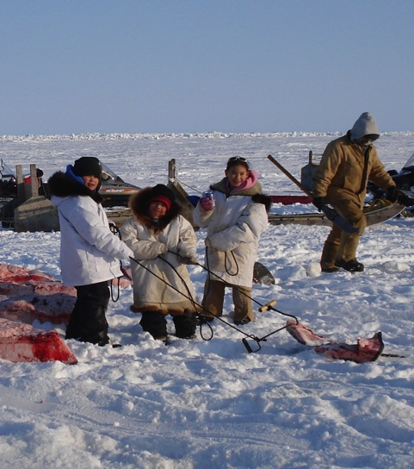
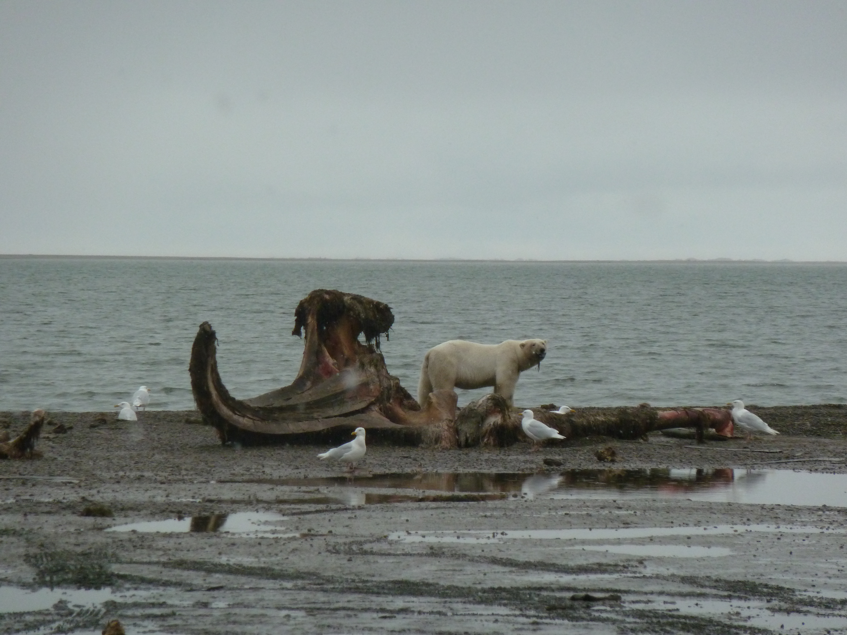
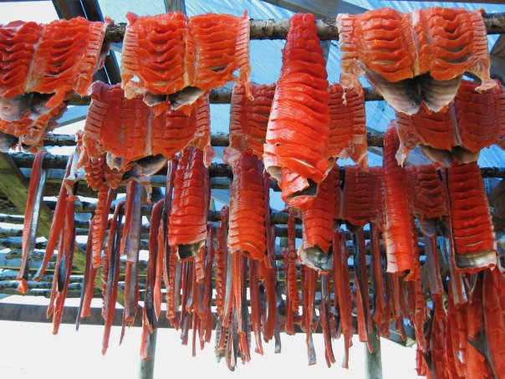
Photo: Carolina Behe
North Slope Borough
Photo: Carolina Behe
Photo: Jacki Cleveland
Notes:
This again requires trust and respect. Trust that we all know what we are speaking about and have the abilitiy to analyze our own information and respect that each of us comes to the table with the creditials needed to be there – for some this may be a degrees and publications – for others this may mean a life time as a hunter or being an elder.

Slide 8
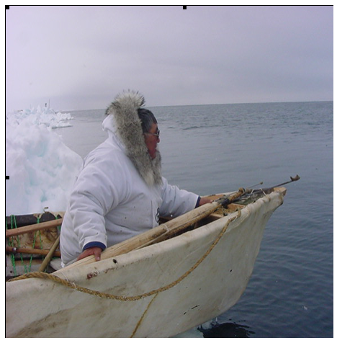
Challenges
North Slope Borough
Notes:
In considering the use of IK within assessments, whether within a co-production of knowledge methodology or by itself, there are many questions to be addressed,
such as what is the best way to store this information;
what is the best way to share this information and to manage its overall use and accessibility, while ensuring that the knowledge holder maintains ownership;
and how to educate a general public on the ethical use of information from Indigenous Knowledge holders.

Slide 9
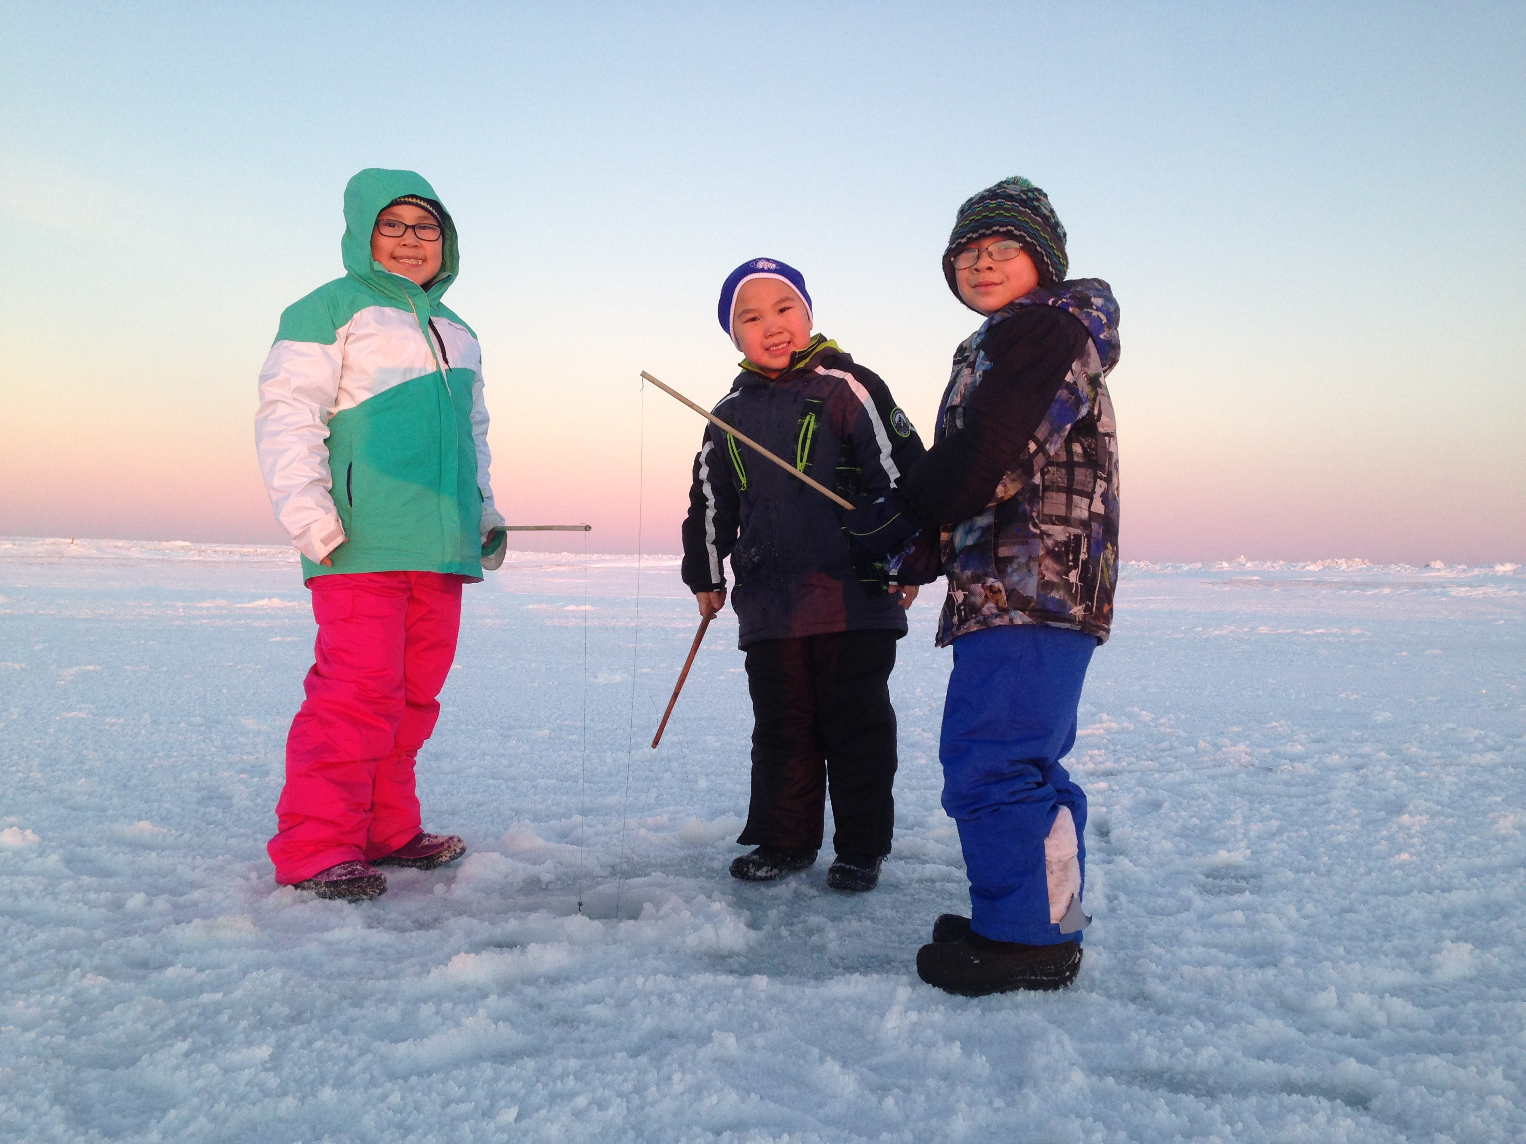
Opportunities
Photo: Mary Sage
Notes:
The opportunity is for us to see the entire picture –
To understand cumulative impacts
To be able to make evidence based decision making

Slide 10
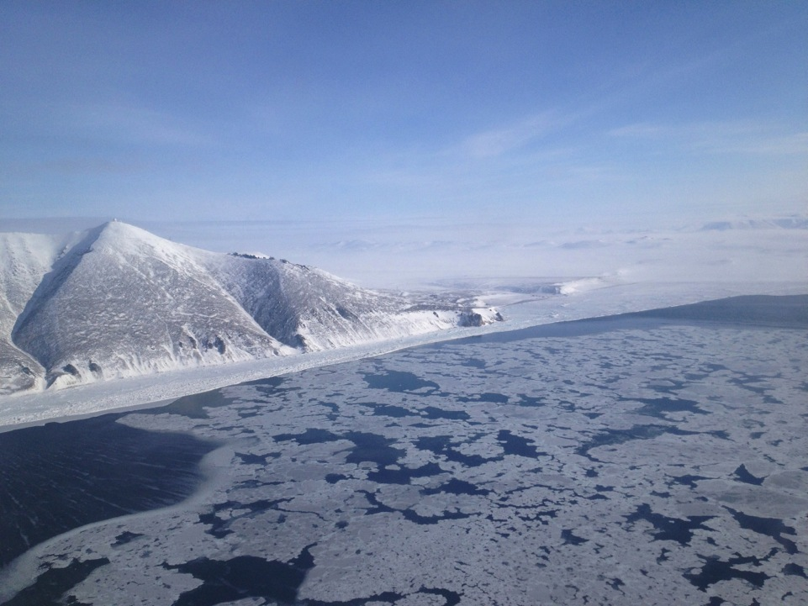
Quyanaq,
Quyana, Taikuu
www.iccalaska.org
carolina@iccalaska.org
Photo: : Carolina Behe
Notes:
In wrapping up…we need trust, we need mutual respect, often times IK and science are asking different questions, IK has its own methodologies,
Think about a co-production of knowledge and how we are going to create this type of platform
What do we get with this approach – a complete image

